Slide 1
Depreciation and Its Method

Slide 2
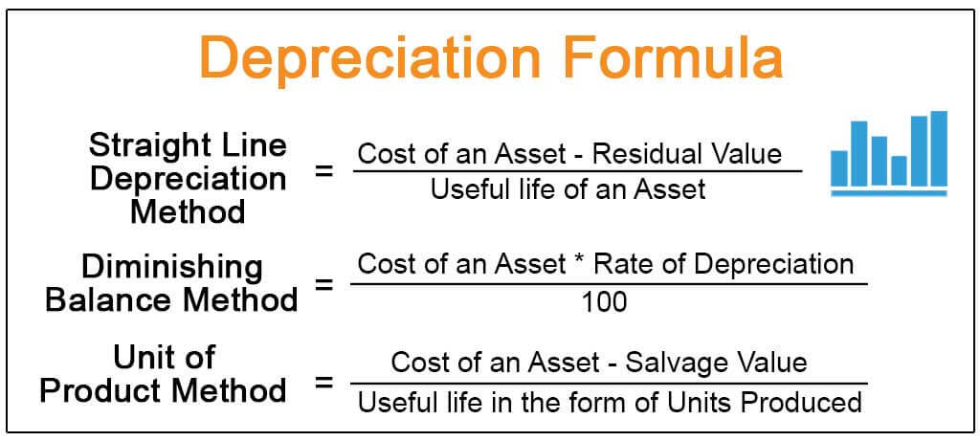
Introduction to Depreciation
Depreciation is the allocation of the cost of a tangible asset over its useful life.
It reflects the wear and tear, obsolescence, or reduction in value of the asset.
Understanding depreciation is crucial for accurate financial reporting and tax purposes.
Notes:
Image source: https://www.wallstreetmojo.com

Slide 3
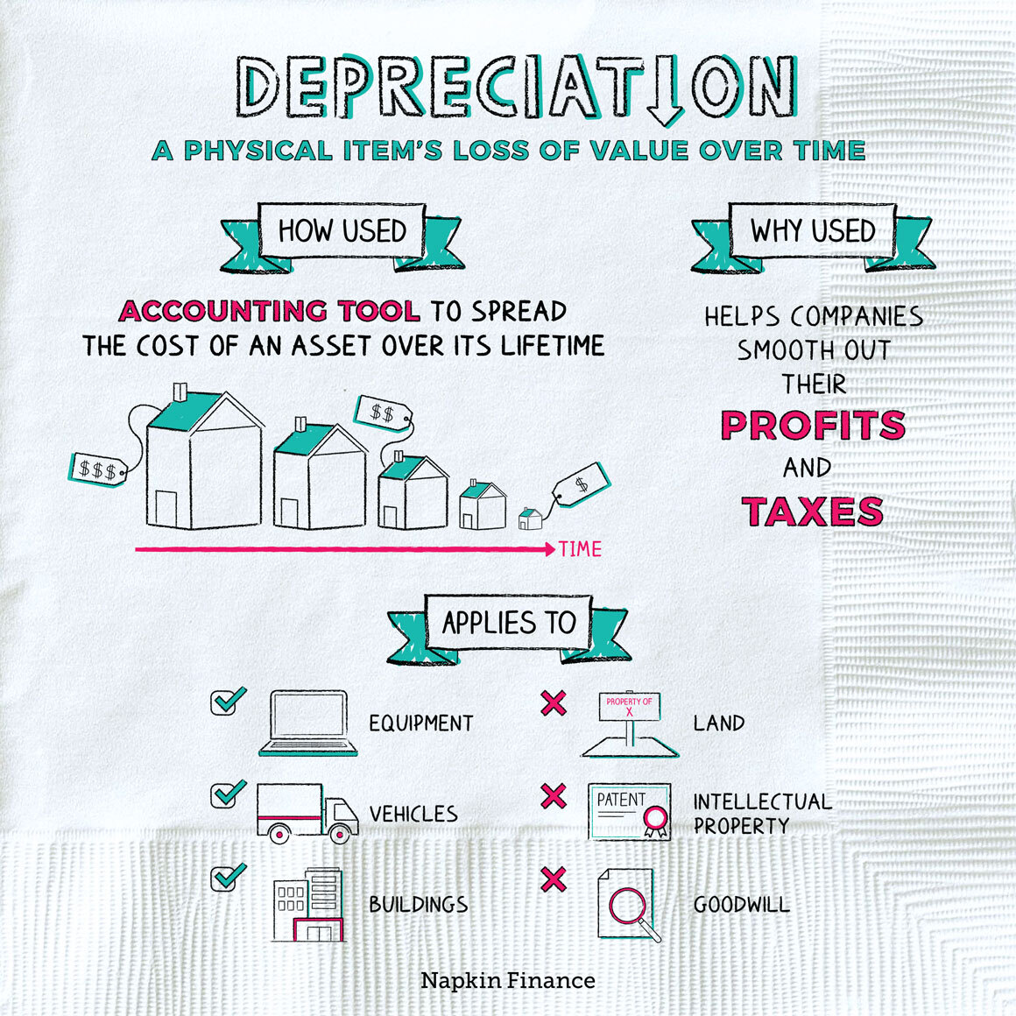
Importance of Depreciation
Depreciation affects the net income of a business, impacting financial statements.
It helps businesses manage tax liabilities by deferring tax payments.
Accurate depreciation calculation aids in investment decisions and asset management.
Notes:
Image source: https://napkinfinance.com

Slide 4
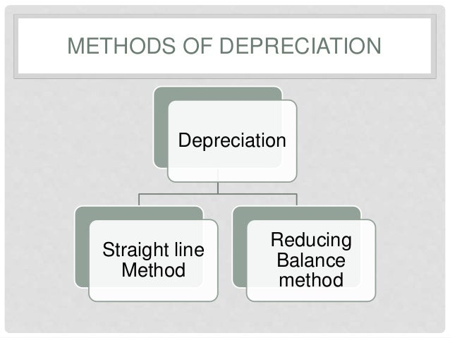
Types of Assets Subject to Depreciation
Depreciation applies to tangible fixed assets, such as buildings and machinery.
It does not apply to land, as land does not lose value over time.
Intangible assets may be amortized, but they are not depreciated.
Notes:
Image source: https://image.slidesharecdn.com

Slide 5
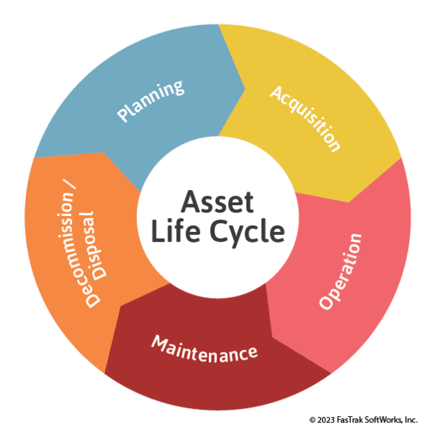
Useful Life of Assets
The useful life is the period over which an asset is expected to be economically useful.
Estimating useful life requires considering factors such as wear and tear and technological changes.
Businesses must regularly review and adjust useful life estimates as necessary.
Notes:
Image source: https://ftmaintenance.com

Slide 6
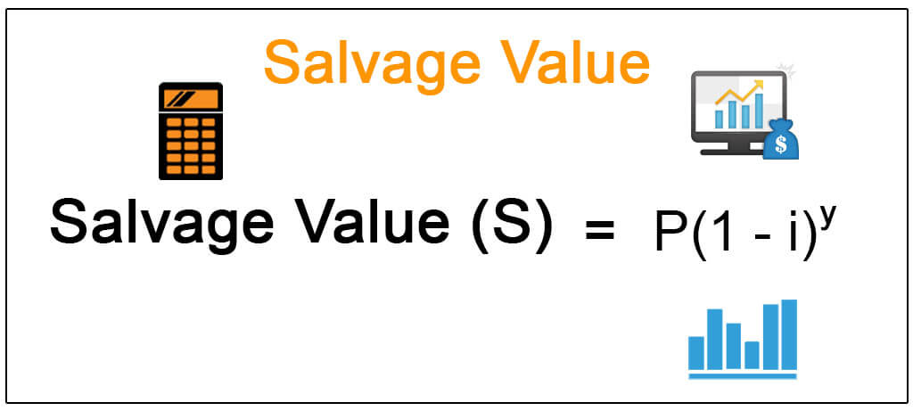
Salvage Value
Salvage value is the estimated residual value of an asset at the end of its useful life.
It plays a crucial role in determining the total depreciation expense.
Accurate estimation of salvage value can significantly impact financial outcomes.
Notes:
Image source: https://www.wallstreetmojo.com

Slide 7
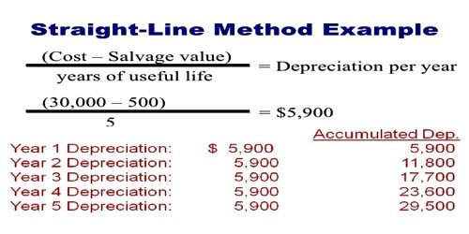
Straight-Line Method
The straight-line method is the most commonly used depreciation method.
It allocates an equal amount of depreciation expense each year over the useful life.
This method is simple to calculate and easy to understand for financial reporting.
Notes:
Image source: https://qsstudy.com

Slide 8
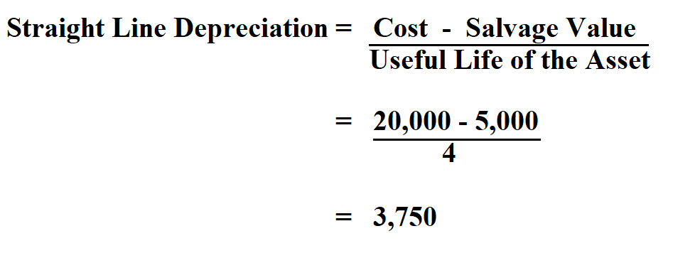
Formula for Straight-Line Depreciation
The formula for straight-line depreciation is (Cost - Salvage Value) / Useful Life.
This provides a constant annual depreciation expense throughout the asset's life.
It is beneficial for assets that provide consistent utility over time.
Notes:
Image source: https://www.personal-accounting.org

Slide 9
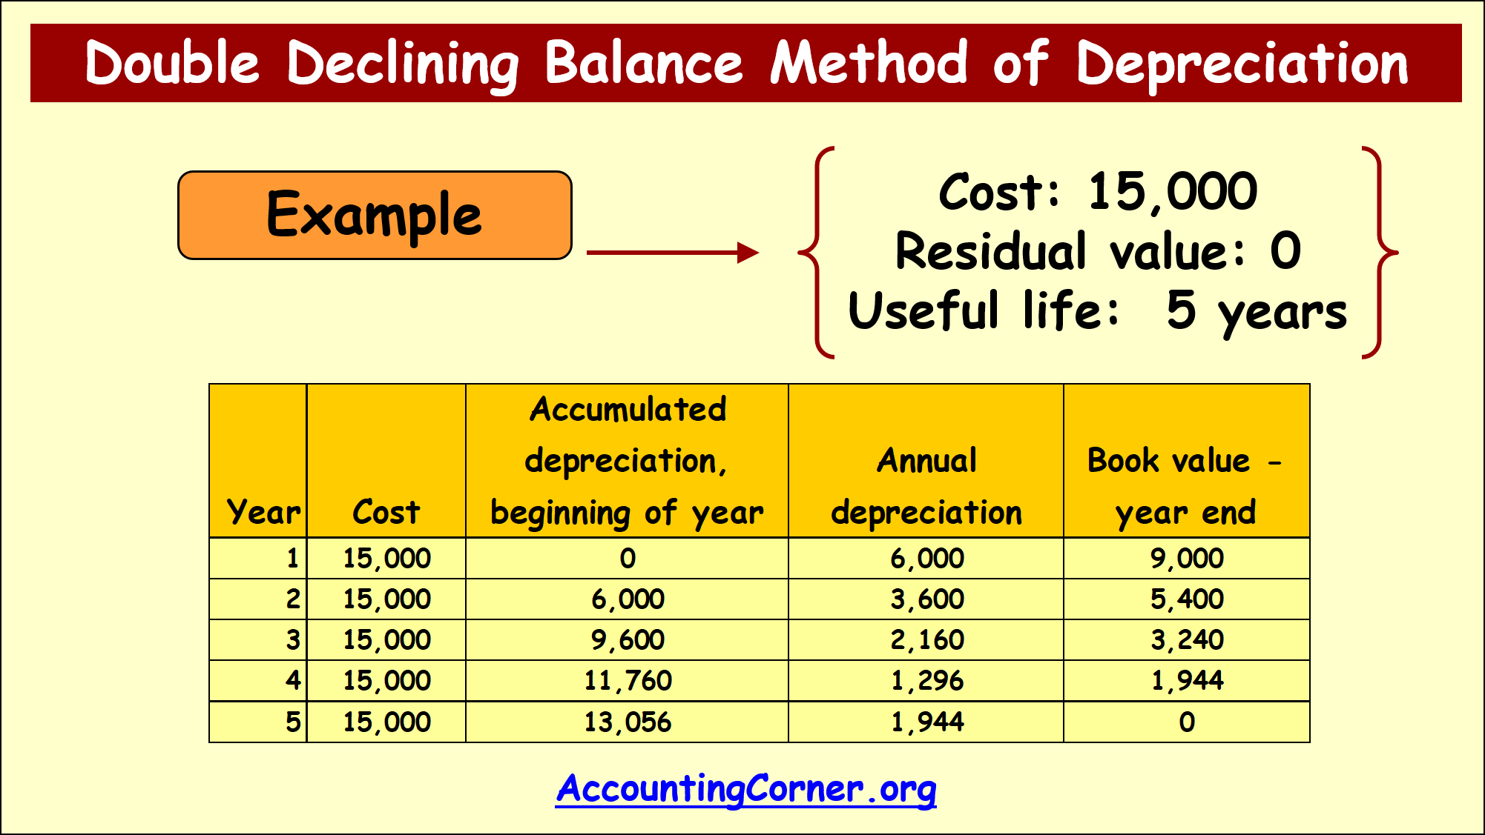
Declining Balance Method
The declining balance method accelerates depreciation in the early years of an asset's life.
This method applies a fixed percentage to the asset's book value at the beginning of each year.
It is useful for assets that lose value quickly or become obsolete faster.
Notes:
Image source: https://accountingcorner.org

Slide 10
Formula for Declining Balance Depreciation
The formula for declining balance depreciation is Book Value at Beginning of Year x Depreciation Rate.
This results in decreasing depreciation expenses over time.
Companies often use double declining balance for higher initial write-offs.
Notes:
Image source: https://www.double-entry-bookkeeping.com

Slide 11
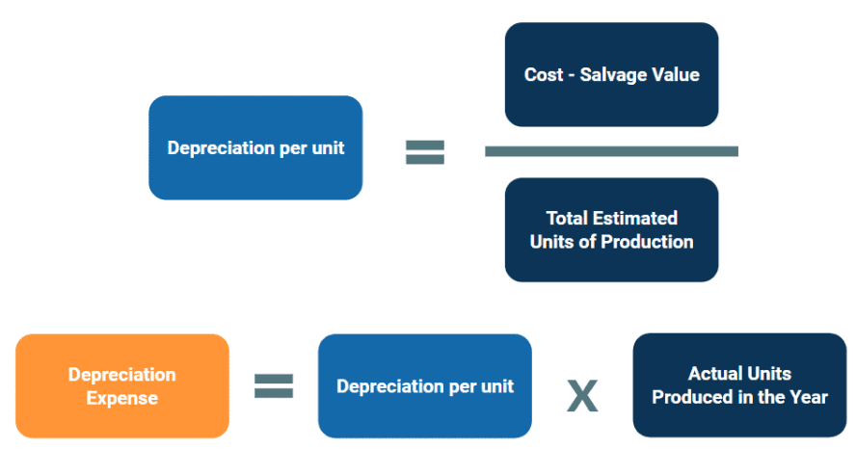
Units of Production Method
The units of production method ties depreciation to actual usage of the asset.
It calculates depreciation based on the number of units produced or hours used.
This method is beneficial for machinery and equipment where usage varies significantly.
Notes:
Image source: https://leasequery.com

Slide 12
Formula for Units of Production Depreciation
The formula is (Cost - Salvage Value) / Total Estimated Units x Units Produced in Period.
This allows for a more accurate representation of an asset’s cost in relation to its use.
It can lead to fluctuating depreciation expenses year over year.
Notes:
Image source: https://www.slidemake.com

Slide 13
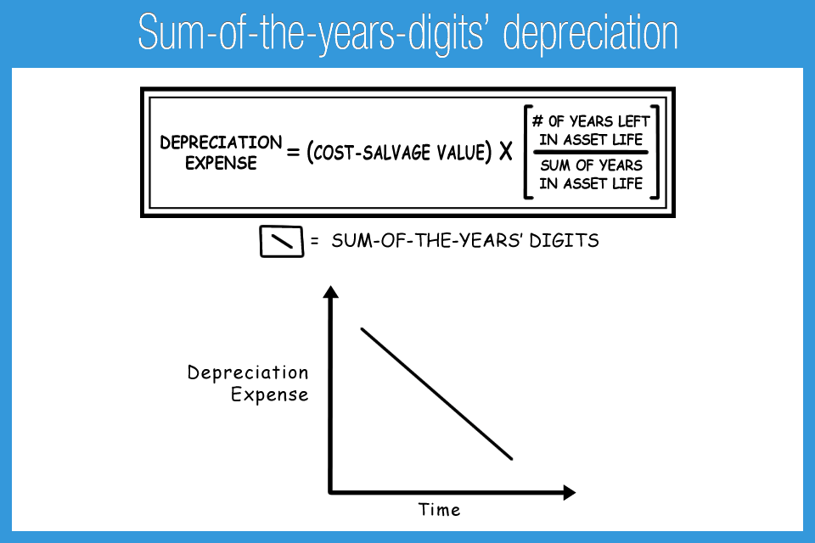
Sum-of-the-Years'-Digits Method
This method accelerates depreciation by applying a decreasing fraction to the asset's cost.
The fraction is based on the sum of the years of useful life.
It results in higher depreciation in earlier years and less in later years.
Notes:
Image source: https://accountingplay.com

Slide 14
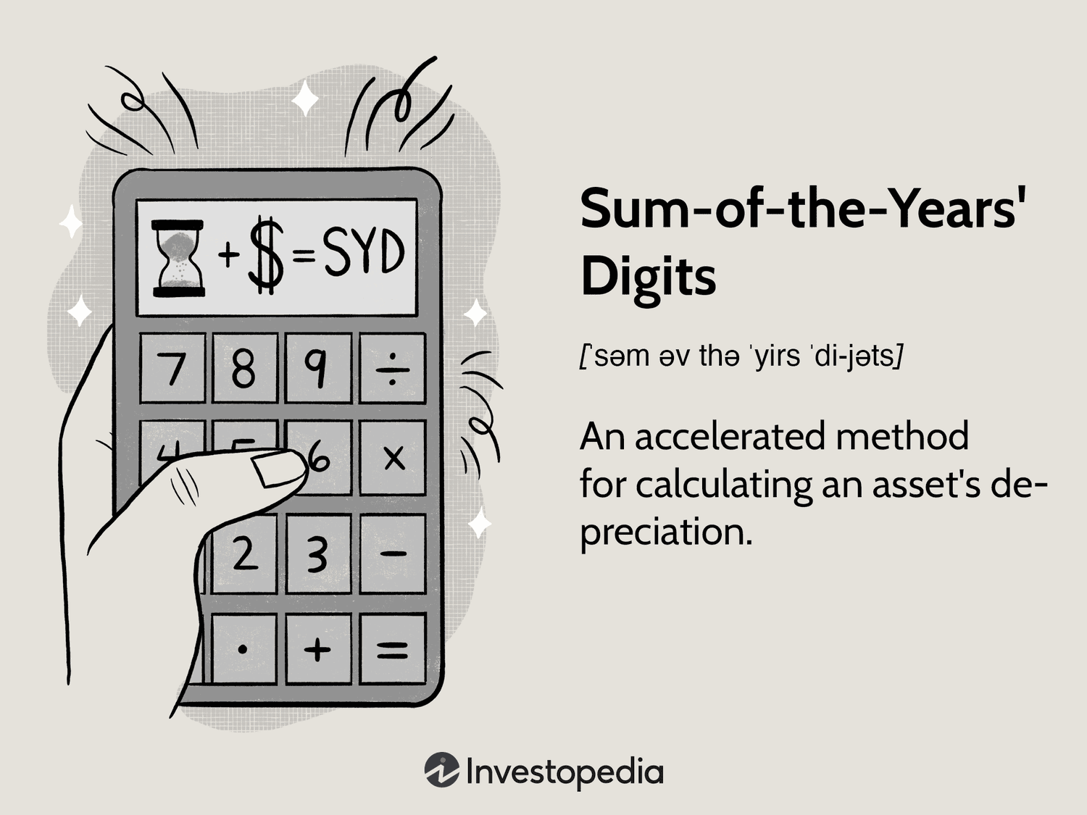
Calculating Sum-of-the-Years'-Digits Depreciation
To calculate, sum the digits of the years of useful life (e.g., for 5 years, 1+2+3+4+5=15).
Then, use the fraction (remaining life/total sum) to determine annual depreciation expense.
This method can better match revenue generation patterns of certain assets.
Notes:
Image source: https://www.investopedia.com

Slide 15
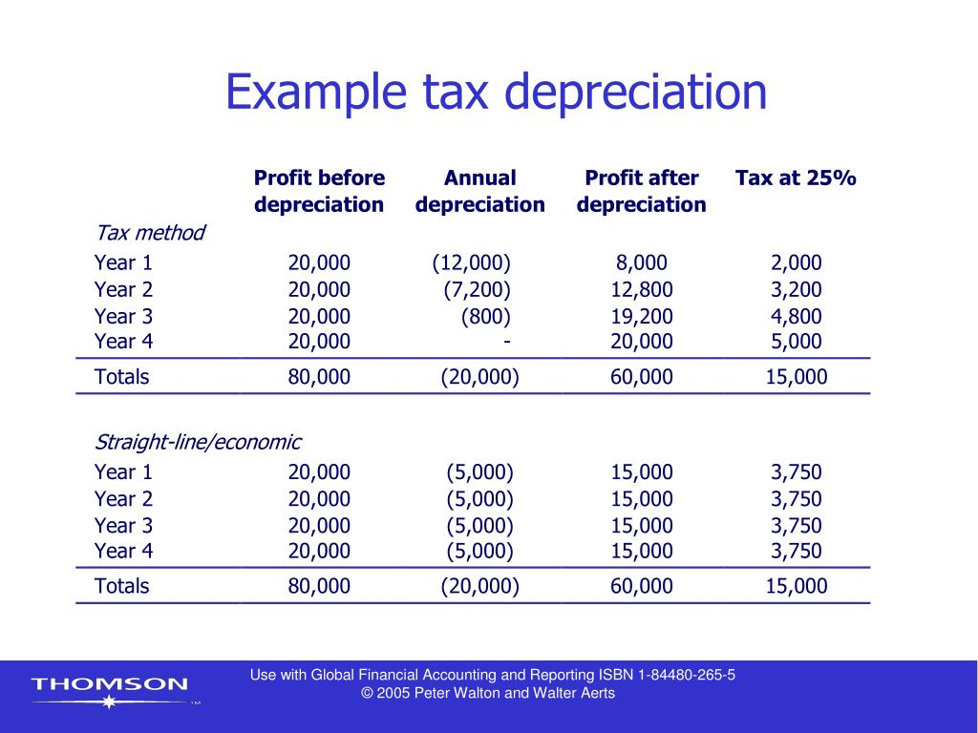
Tax Implications of Depreciation
Depreciation can significantly reduce taxable income, impacting cash flow.
Different methods can yield varying tax benefits depending on the financial strategy.
Understanding tax regulations is essential for optimal depreciation strategy.
Notes:
Image source: https://image.slideserve.com

Slide 16
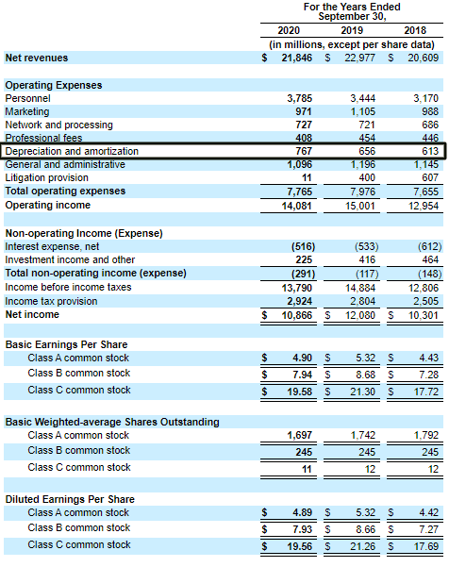
Depreciation and Financial Statements
Depreciation affects both the income statement and balance sheet of a company.
It reduces taxable income on the income statement while impacting asset valuation on the balance sheet.
Investors often analyze depreciation trends to assess financial health.
Notes:
Image source: https://eor7ztmv4pb.exactdn.com

Slide 17
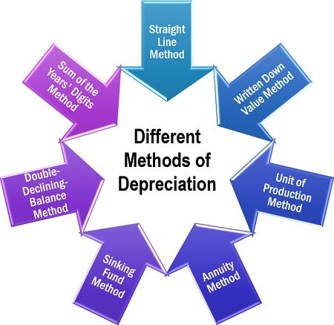
Depreciation in Different Industries
Different industries may prefer different depreciation methods based on asset usage.
Manufacturing industries may favor units of production, while service industries may prefer straight-line.
Understanding industry standards is vital for compliance and benchmarking.
Notes:
Image source: https://theinvestorsbook.com

Slide 18
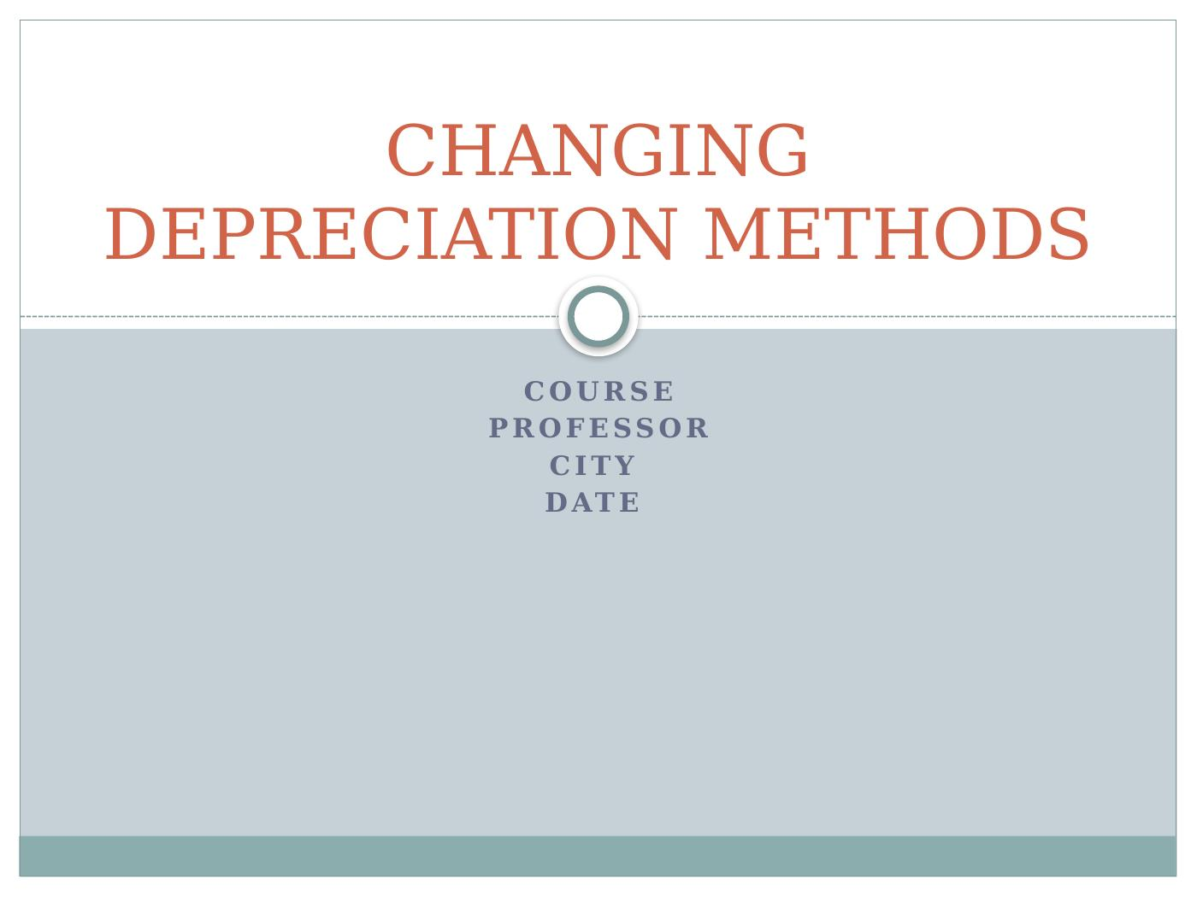
Changing Depreciation Methods
Businesses can change depreciation methods if justified, but must disclose it.
The new method should better reflect the asset's utility and economic reality.
Changes can affect financial ratios and investor perceptions.
Notes:
Image source: https://desklib.com

Slide 19
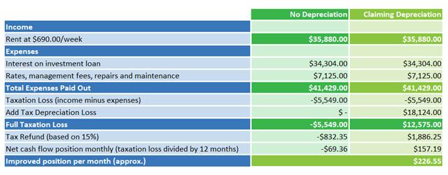
Common Mistakes in Depreciation
Common mistakes include inaccurate estimates of useful life and salvage value.
Failing to update depreciation schedules can lead to misstatements in financial reporting.
Regular audits and reviews can help mitigate these errors.
Notes:
Image source: https://www.capitalclaims.com.au

Slide 20
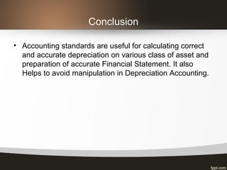
Conclusion
Understanding depreciation is essential for accurate financial management.
Choosing the right method can have significant tax and cash flow implications.
Businesses should regularly review their depreciation strategies for optimal results.
Notes:
Image source: https://image.slidesharecdn.com

Slide 21
Notes:
Image source: https://img.haikudeck.com

